Slide 1

A Project Review Presentation on Real-Time Driver Drowsiness Detection Using Mobile Net for Road Safety Enhancement
Presented by Batch CS 25-03
Mallavarapu Sravika 21121A3732
Shaik Ayesha 21121A3748
Dungavath Sridhar Naik 21121A3715
Vangipuram Anil Kumar 21121A3758
Muthyamaina Pavan Kumar 21121A3737
Computer Science and Systems Engineering
Under the guidance of
Ms. Chengamma Chitteti,
Assistant Professor,
Dept. of IT
HOD
Dr. K. Reddy Madhavi ,
Professor & Head,
Dept. of CSSE

Slide 2
Contents
Abstract
Introduction
Statement of the problem
Motivation
Objectives
Literature Survey
Limitations of Existing Methods
Proposed System
Software and Hardware Requirements
Simulation Model
Performance Evaluation
Analysis of Experimental Data
Implementation and Results
Conclusions
Future Work
References

Slide 3
Abstract
In present-day world, accidents are caused mainly due to driver drowsiness. This paper introduces a real time driver sleep detection system that uses MobileNet, a lightweight convolutional neural network (CNN) architecture optimized for mobility and indoor environments. The system captures live video of the driver’s face to detect signs of fatigue that may lead to fatigue, such as prolonged eye closure and yawning. MobileNet’s low cost makes it fast and suitable for integration into vehicles without sacrificing accuracy. The instant alert model provides instant feedback, reducing the risk of fatigue and improving overall safety. The proposed system is scalable, cost- effective, and can run on mobile devices, making it an ideal solution for modern vehicle safety applications. Fatigue cues to prevent accidents. Drowsiness affects making, and alertness, increasing the risk of accidents. Results show that the MobileNet model achieves 99% performance when combined with the k neighbor classifier. The system detects, fatigue in 0.00829 seconds, making it ideal for immediate.

Slide 4
Introduction
Driver fatigue is a significant factor contributing to road accidents worldwide, leading to thousands of fatalities and injuries each year. Drowsiness can impair a driver’s ability to react quickly, affecting decision-making and alertness, which increases the risk of accidents. Current systems for detecting driver fatigue often rely on physical signals, such as heart rate or steering behavior, which can be intrusive and distracting. This project proposes a real-time driver drowsiness detection system that utilizes facial recognition technology to monitor signs of fatigue. The system focuses on detecting key fatigue cues, such as prolonged eye closure, yawning, and other facial expressions indicative of drowsiness. This project aims to enhance road safety by providing a fast, accurate, and reliable solution for detecting and preventing accidents caused by driver fatigue.

Slide 5
Problem Statement
Driver fatigue is a leading cause of road accidents, contributing to thousands of fatalities and injuries each year. Traditional methods of detecting drowsiness often rely on physical signals, which can be intrusive and may distract the driver from the road. Current fatigue detection systems may not provide real-time alerts, increasing the risk of accidents before the driver is notified. Many existing systems require expensive and complex hardware, making them impractical for widespread adoption in vehicles.
There is a need for a fast, accurate, and cost-effective solution to detect driver fatigue in real-time, without causing distractions or requiring direct contact with the driver. A scalable system that can run on mobile devices and integrate seamlessly into vehicles is essential to improve road safety and reduce accidents caused by driver drowsiness.
.

Slide 6
Motivation
Driver fatigue is a critical factor in road accidents, and addressing it can significantly reduce the number of fatalities and injuries caused by drowsy driving. Traditional fatigue detection systems are often intrusive, expensive, and require complex hardware, making them less practical for widespread use in vehicles. Real-time detection and immediate feedback can help drivers take timely action, preventing accidents before they occur and improving overall road safety. The increasing use of mobile devices and embedded systems in vehicles presents an opportunity to create a lightweight, cost-effective solution that can be easily integrated into existing infrastructure. By developing a system that is both efficient and scalable, this project aims to contribute to the advancement of driver safety technology, benefiting both individual drivers and the broader transportation industry.

Slide 7
Objectives
To develop a real-time driver drowsiness detection system using MobileNet, a lightweight convolutional neural network (CNN), to accurately detect signs of fatigue from facial expressions.
To monitor key fatigue cues, such as prolonged eye closure and yawning, from the driver’s face using a live video feed for early detection of drowsiness.
To ensure the system provides instant feedback to the driver, alerting them of fatigue and reducing the risk of accidents caused by drowsiness.
To design a cost-effective and scalable solution that can be integrated into modern vehicles without the need for expensive hardware or intrusive sensors.

Slide 8
Literature Survey
Rohith Chinthalachervu et al. [1] proposed a method to detect the drowsy status of driver as well equipped with appropriate reactions according to traffic rules. They found that most of the road accidents took place due to driver fatigue and this is a hard thing to observe. This system achieves 95.58% sensitivity and 100 % specificity using a Support Vector Machine (SVM) classifier in combination
Yaman Albadaw et al. [2] proposed a non-touchless system for automatic driver sleepiness diagnosis based on visual appearance of drivers using dashboard-camera videos, [ Their methodology uses facial landmarks to detect the head pose and also computes key features for mouth aspect ratio, eye aspect ratio.

Slide 9
Limitation of Existing Methods
Existing systems often require intrusive sensors that can distract or discomfort the driver.
High-cost hardware, such as infrared cameras, makes integration difficult and expensive.
Many systems are reactive, providing alerts only after fatigue signs are clearly visible.

Slide 10
Proposed System
The proposed system uses MobileNet, a lightweight convolutional neural network (CNN), to detect signs of driver fatigue through facial recognition and eye movement analysis.
It captures live video of the driver’s face and processes it in real-time to detect key fatigue cues, such as prolonged eye closure and yawning.
The system provides instant feedback to alert the driver as soon as fatigue signs are detected, allowing them to take timely action and reduce accident risks.
MobileNet's efficiency ensures the system operates with low computational cost, making it suitable for integration into vehicles without requiring expensive hardware.

Slide 11
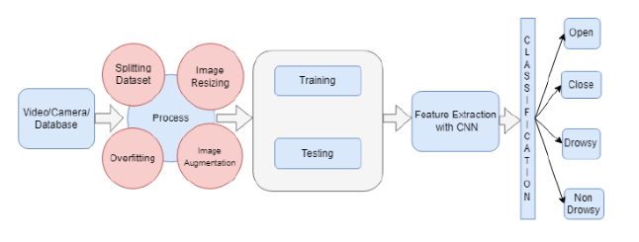
Architecture - Proposed System
Fig: Architecture For Proposed System

Slide 12
Specifications
Hardware Requirements
PROCESSOR : Intel I5 and above
RAM : 4GB Or More
HARD DISK : 50 GB Or More

Slide 13
Software Requirements
PYTHON IDE : Anaconda Python
BACK END : Google Collab
FRONT END : Django frame
PROGRAMMING LANGUAGE : Python

Slide 14
Simulation Model
Data Flow:
The Input Layer preprocessed video Images of the driver's face.
The Output is fed into lightweight.
Real-Time Implementation:
The camera streams input to the processing unit, it runs inference.
Simulation Setup:
Dataset, Framework, Testing Environment

Slide 15
Performance Evaluation
Metrics:
Accuracy: The percentage correct drowsiness classifications.
Inference Time: Time taken by the model to process a frame.
Testing Scenarios:
Day vs. night conditions.
Different driver postures and facial occlusions
Variations in lighting and camera angles.
Results:
It achieves high accuracy 90% in detecting signs of such as yawning.

Slide 16
Analysis of Experimental Data
Dataset Analysis:
Class distribution: Balanced representation of Drowsy.
Model Performance:
Confusion Matrix: Shows true positives, true and false negatives.
Receiver Operating Characteristic (ROC) Curve
Insights:
Significant impact of environmental factors on detection accuracy.

Slide 17
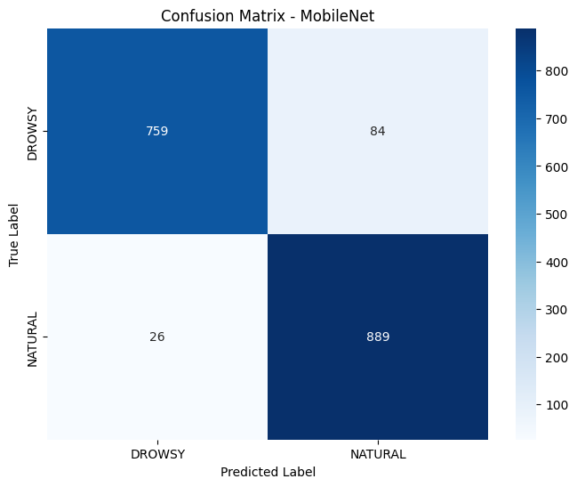
Prediction Model

Slide 18
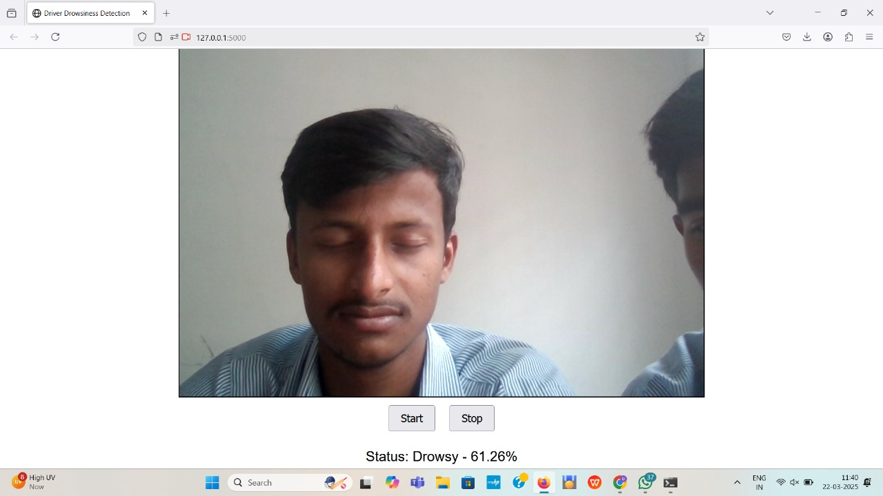
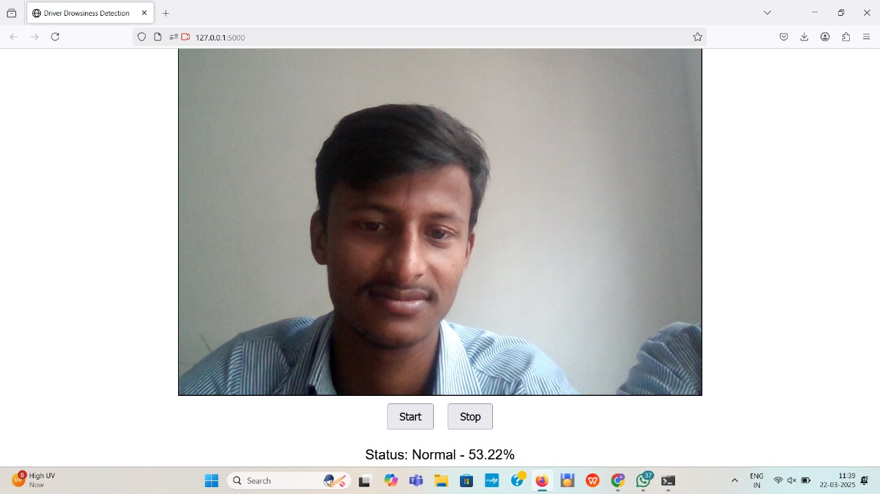
Implementation and Results

Slide 19
Conclusion
The main target of this research project explores driver fatigue as the major cause of road accidents.
MobileNet architecture allows detection of drowsiness indicators by achieving a 94% accuracy rate because it performs effective detection for eye closure duration and yawning detection.
The system detects tiredness immediately thus allowing it to alert users about potential traffic dangers as soon as possible.
This system serves as a practical and economical solution for safety systems within vehicles so they can become accessible to all models despite existing implementation challenges.
The established project proves the availability of an operational ready and financially suitable system that detects drowsiness and serves to eliminate avoidable road fatalities while creating safer roads.

Slide 20
Future Work
Adaptive AI for Diverse Driver Demographics.
User-Friendly Interface & Feedback System.
Edge AI & IoT Connectivity
Future work will focus on multi-sensor integration and AI-powered behavioral analysis for even better accuracy.

Slide 21
Reference
1. R. Chinthalachervu, I. Teja, M. A. Kumar, N. S. Harshith, and T. S. Kumar, "Driver Drowsiness Detection and Monitoring System using Machine Learning," 2022.
2. Y. Albadaw, A. AlRedhaei, and M. Takruri, "Real-Time Machine Learning-Based Driver Drowsiness Detection Using Visual Features," 2023.
3. P. Pandey, M. Sharma, P. Saxena, and R. K. Dwivedi, "Driver Drowsiness Monitoring and Detection using Machine Learning," 2023.
4. S. Pachouly, N. Bhondve, A. Dalvi, V. Dhande, and N. Bhamare, "driver drowsiness detection using machine learning with visual behaviour," IJCRT, vol. 2020.
5. D. Sruthi, A. Amulya Reddy, G. S. Siddaharth Reddy, and S. Shesham, "Driver Drowsines s Detection System using Deep Learning," IJRASET, 2023.
6. R. Thakur, S. Shivam, S. Raj, and S. Pandey, "Driver Drowsiness Detection System Using Machine Learning," doi:10.3233/ATDE220718, 2022.

Slide 22
Thank You

